Slide 1
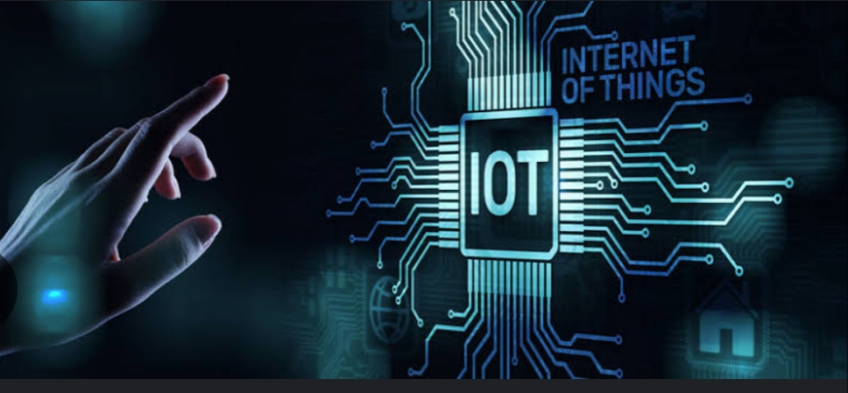
TITLE
IoT in cloud computing
Presented by
ELECTRONICS AND COMMUNICATION ENGINEERING,
RAJIV GANDHI COLLEGE OF ENGINEERING AND TECHNOLOGY
MOHAMED RIAZUDEEN.M

Slide 2
2
Agenda
Introduction
History
IOT
How it works
Applications
Home automation
Progress of indian
Benefits and Risks
Conclusion

Slide 3
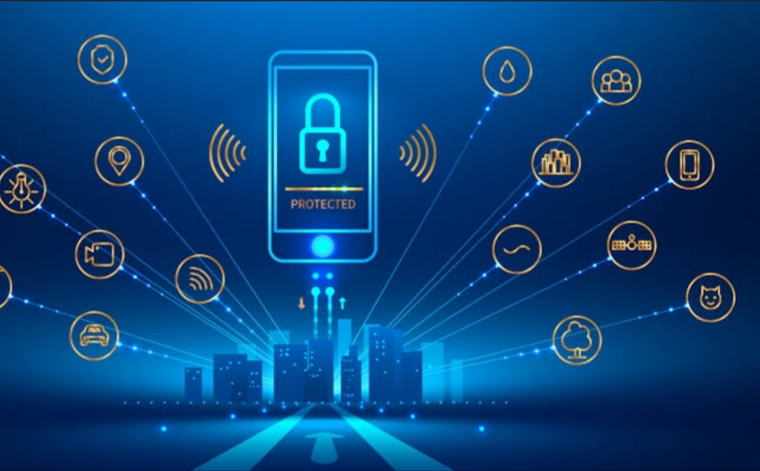
3
Introduction
The internet of things is the extension of internet connectivity into physical devices and everyday objects.
Iot is simply the network of interconnected things/devices which are embedded with sensor, software, network connectivity and necessary electronics that enables them to collect and exchange data making them responsive.
It means taking all the things in the world and connecting them to the internet.

Slide 4
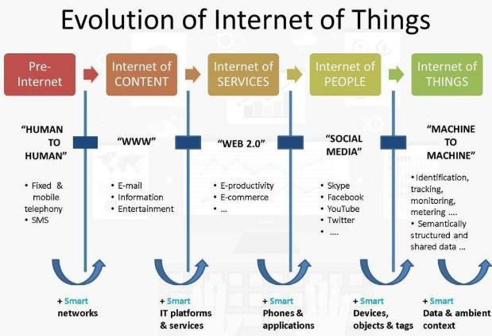
History
4

Slide 5
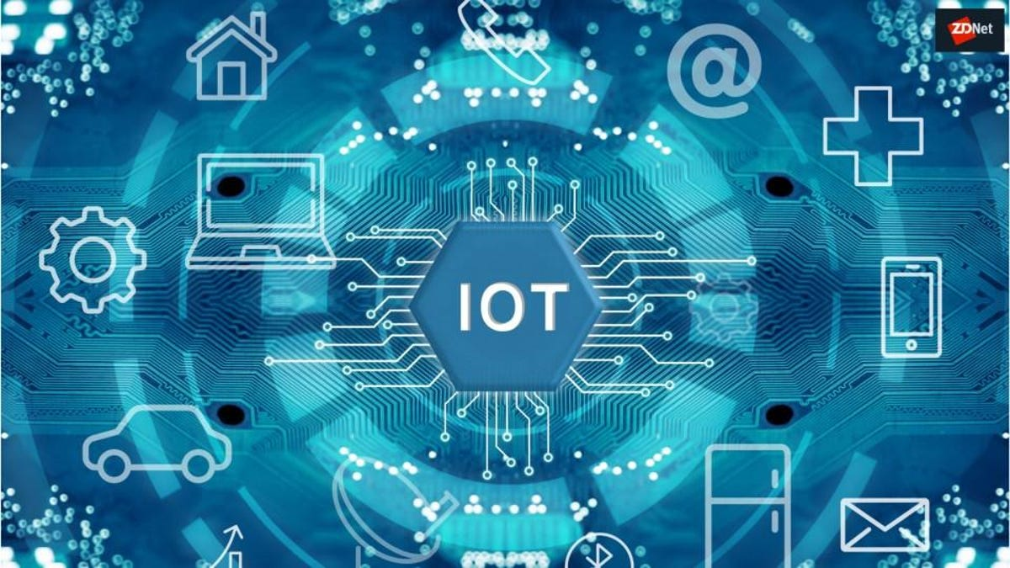
What is IoT
5
Internet of Things, refers to the collective network of connected devices and the technology that facilitates communication between devices and the cloud, as well as between the devices themselves.

Slide 6
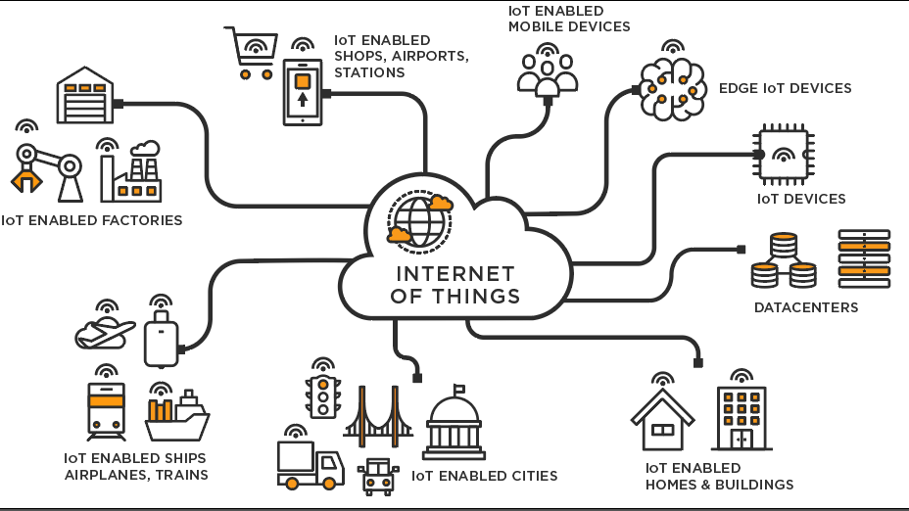
6
How it work
Devices carefully select only particular data that is relevant to execute an action. These pieces of information can detect patterns, recommendations and problems before they occur.
IoT application works with smart systems that automate tasks to address specific needs.
These devices, often called "connected" or "smart" devices, can sometimes talk to other related devices, a process called machine-to-machine(M2M) communication, and act on the information they get from one anothe

Slide 7
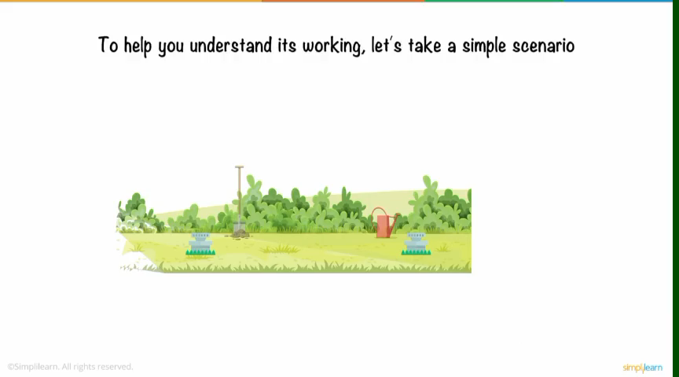

Slide 8
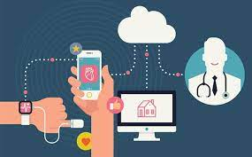
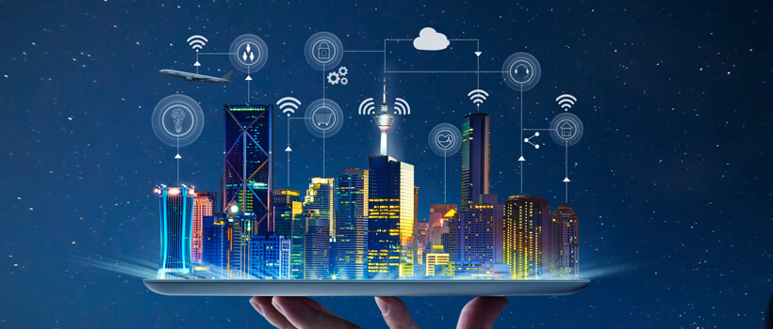
Application
8
Healthcare
Smart City

Slide 9
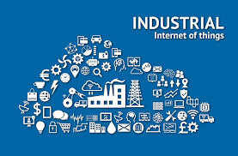
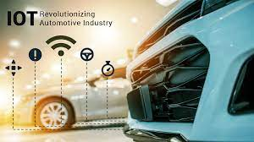
9
Industrial Internet
Connected Car

Slide 10
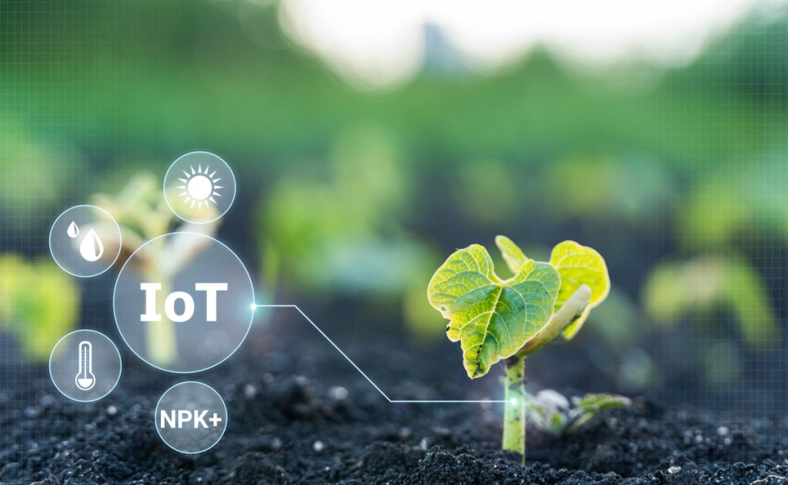
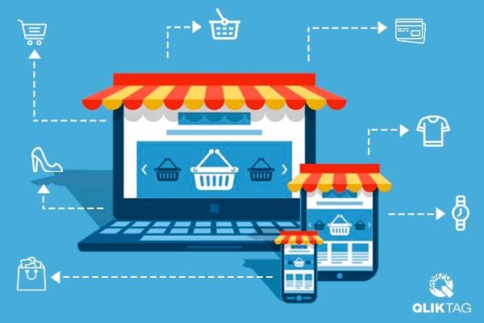
10
Smart Farming
Smart Retail

Slide 11
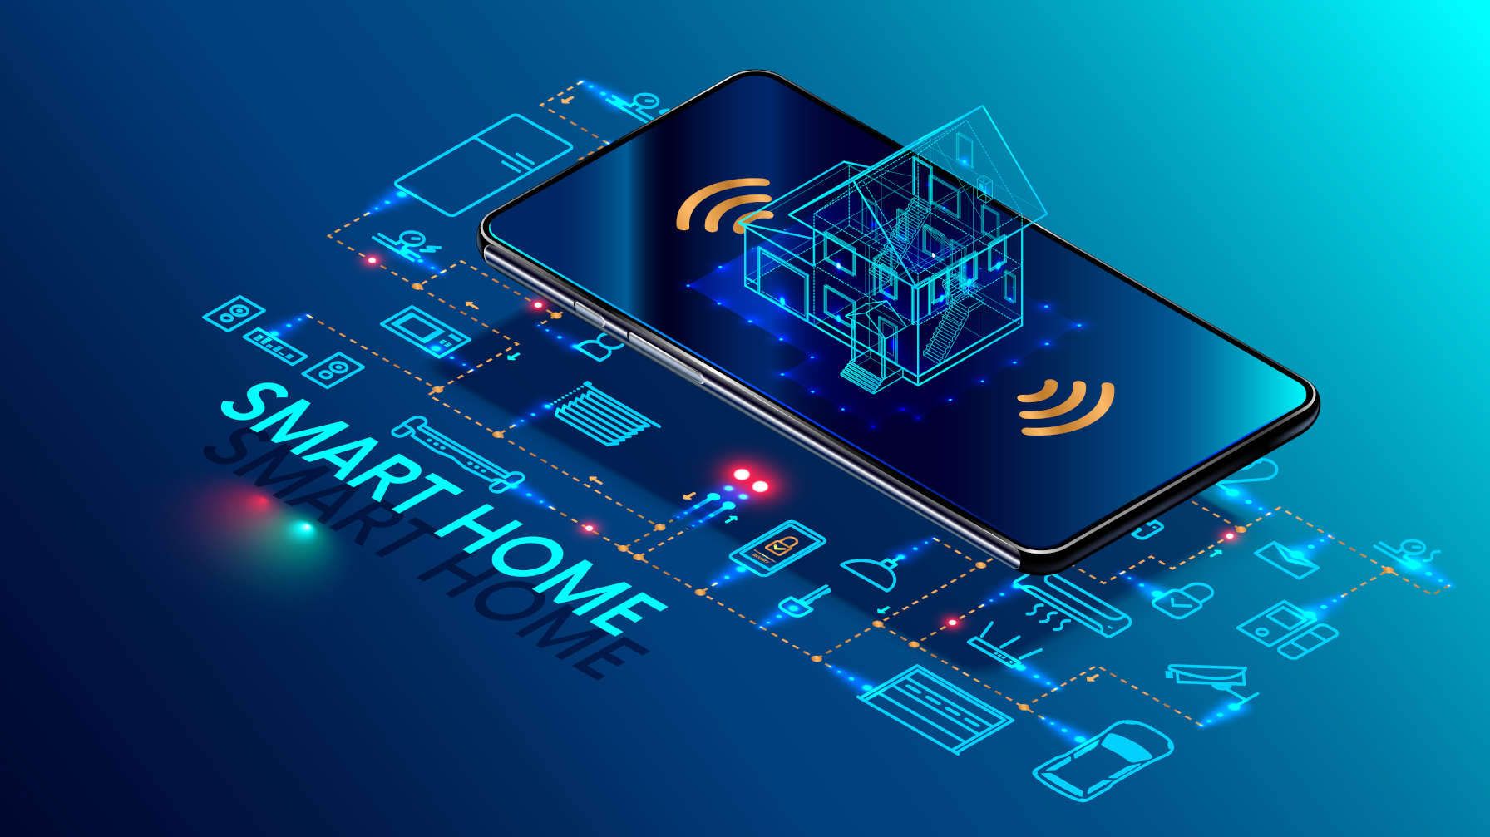
Smart Home
A part of IoT, smart home systems and devices Often operate together , sharing consumer Usage data among themselves and Automating actions based on the home Owner's preferences.

Slide 12
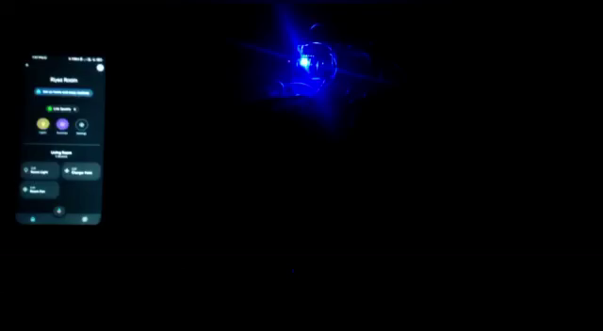

Slide 13
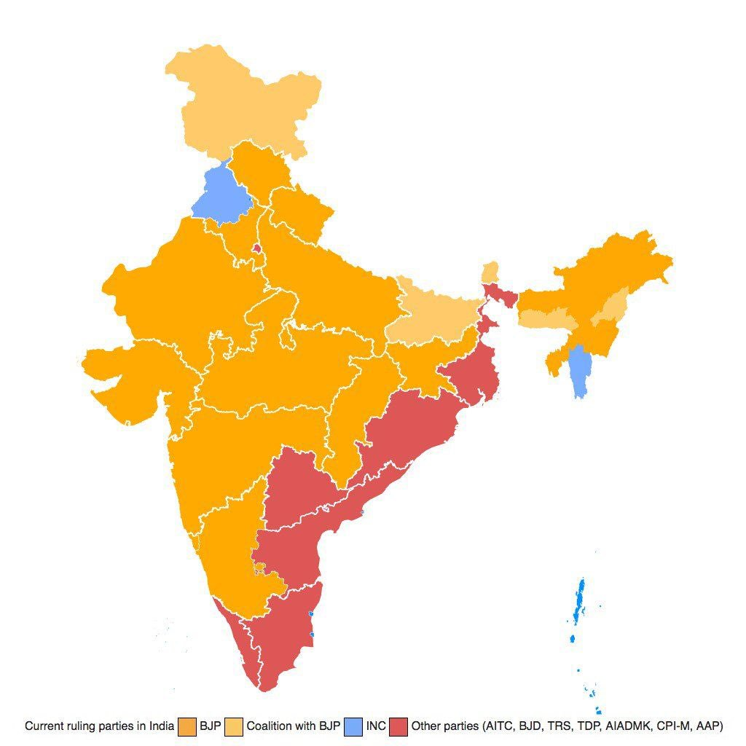
13
Progress of India
The Indian government outlined a plan to leverage lot as part of the Digital India mission. There is a *7,000- crore budget to develop 100 smart cities, conserve water and power, and improve healthcare, transportation, and security.
Investing in lot will boost our economy on par with global leaders. IoT will bring in investments, create jobs and improve Indian public infrastructure.
I
O
T

Slide 14
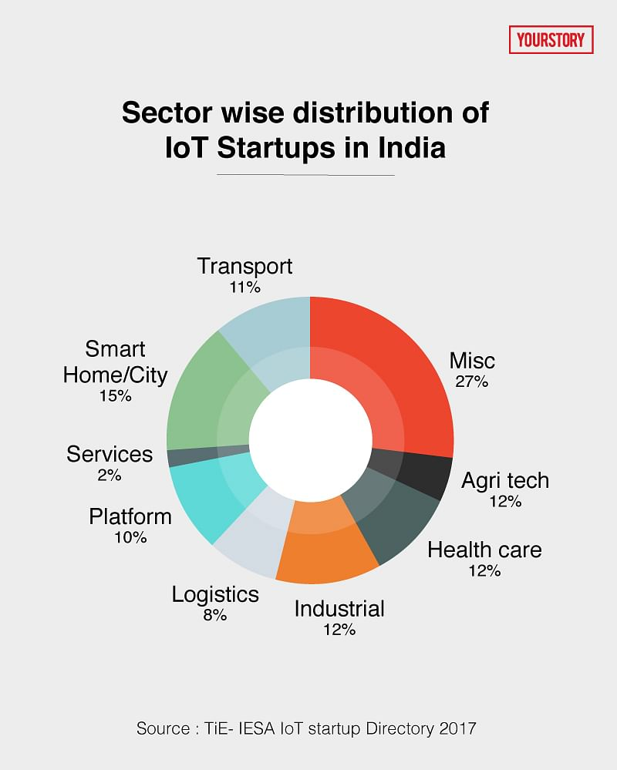
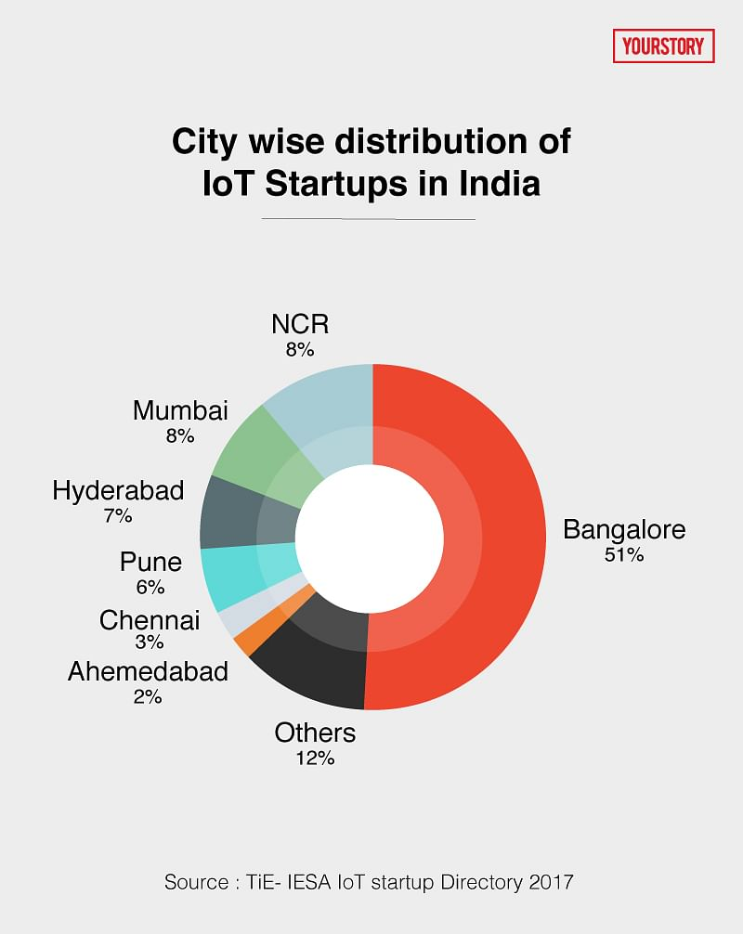

Slide 15
15
Benefits
*Ability to accesses information from anywhere at any time on any device
*Improved communication between connected electronic devices
*Transferring daata packets over a connected network saving time and money
*Automating tasks helping to improve the quality of a buisiness's services and reducing the need for human interacton

Slide 16
16
Risks
*As the number of connected devices increases and more information is shared between devices, the potential that a hacker could steal confidetial information also increases.
*Enterprises may eventually have to deal with massive numbers maybe even millions of iot devices, and collecting and managing te data from all those devices will be challenging.
*If there's a bug in the system, it's likely that every connected device will become corrupted.

Slide 17
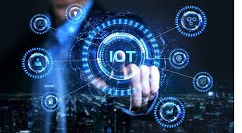
17
Conclusion
As best as we can see, much of this future unfolds in the context of the Internet of Things. In fact, we envision that all industrial and infrastructure environments, and cyber-physical systems in general, will take the form reminiscent of what today is referred to as the Internet of Things.

Slide 18
18
References
https://www.google.com/search?q=conclusion+for+iot&source=lnms&tbm=isch&sa=X&ved=2ahUKEwjoi63q-8_9AhU5znMBHQI5BtUQ0pQJegQIBhAC&biw=1366&bih=657&dpr=1
https://www.hcltech.com/technology-qa/what-are-benefits-iot
https://www.oracle.com/in/internet-of-things/what-is-iot/
https://www.rfpage.com/applications-of-internet-of-things-iot/
https://www.simplilearn.com/iot-devices-article#:~:text=Types%20of%20IoT,-The%20networking%2C%20communication&text=Consumer%20IoT%20%2D%20Primarily%20for%20everyday,smart%20pacemakers%20and%20monitoring%20systems.

Slide 19
